Slide 2
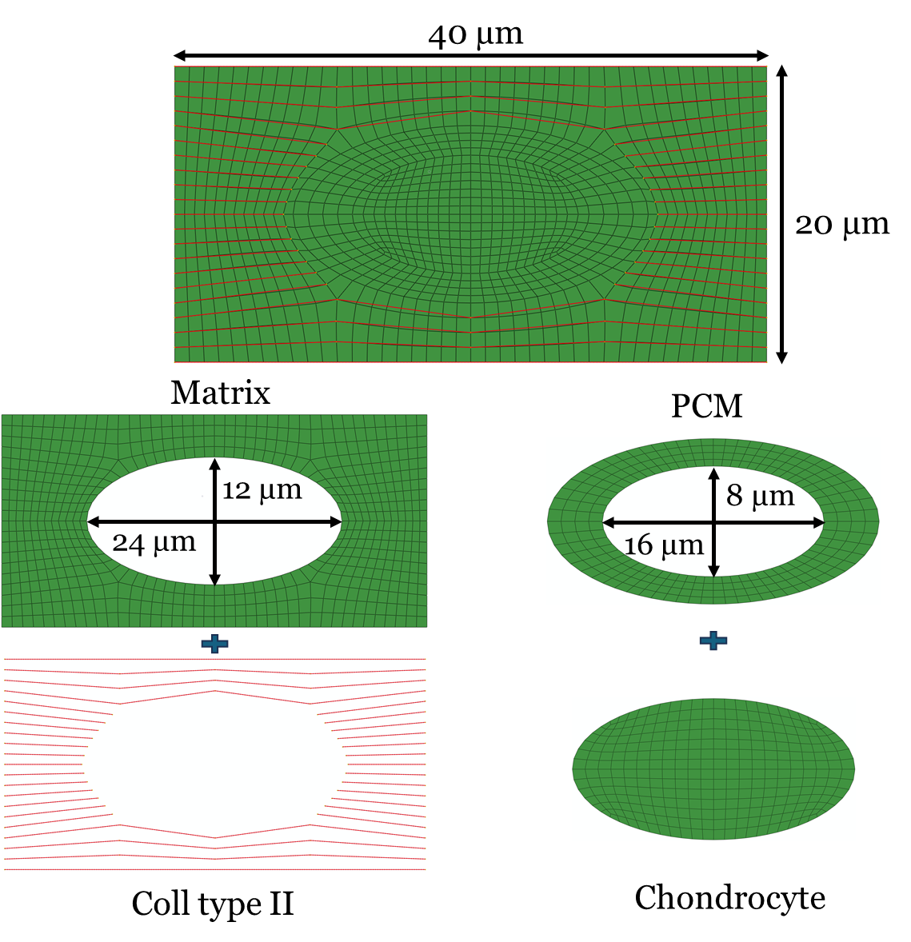
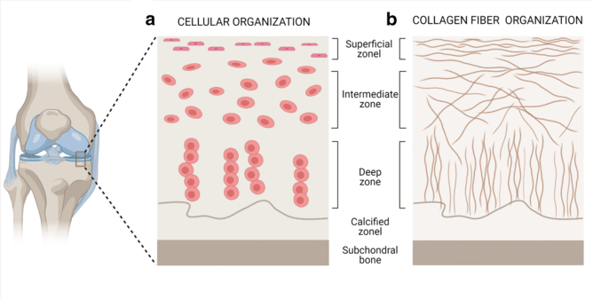
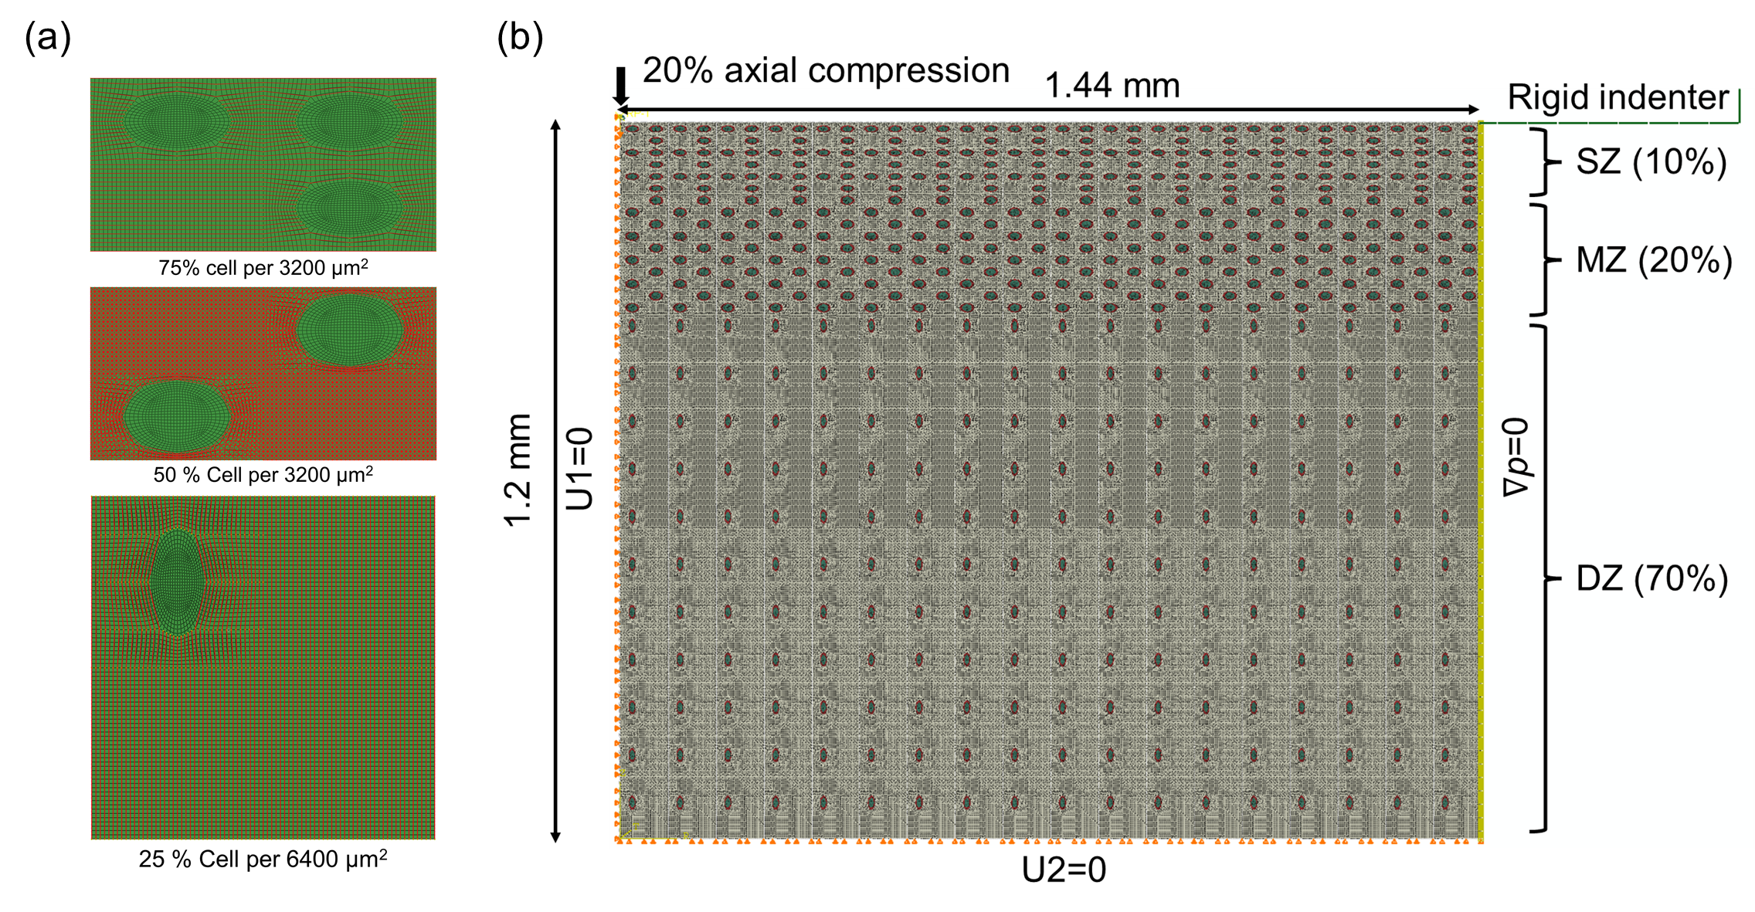
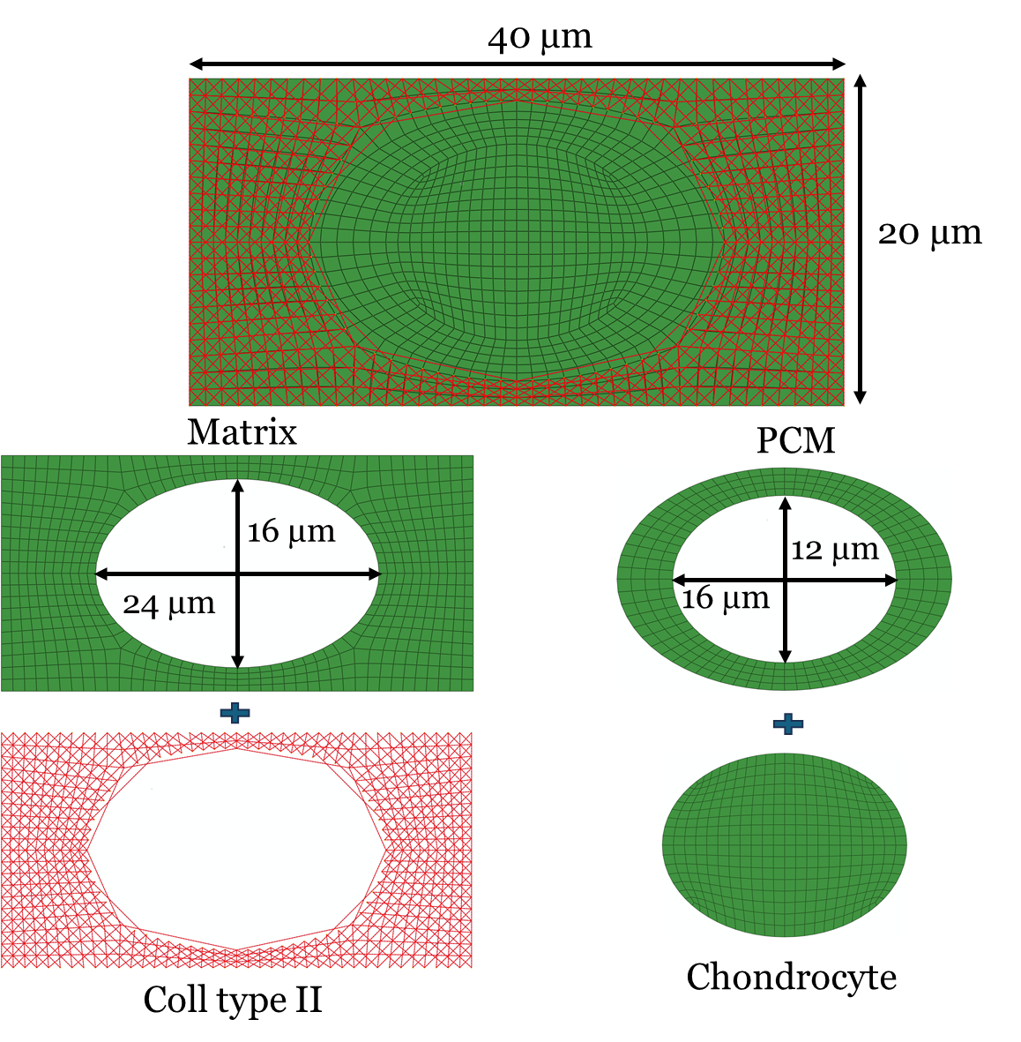
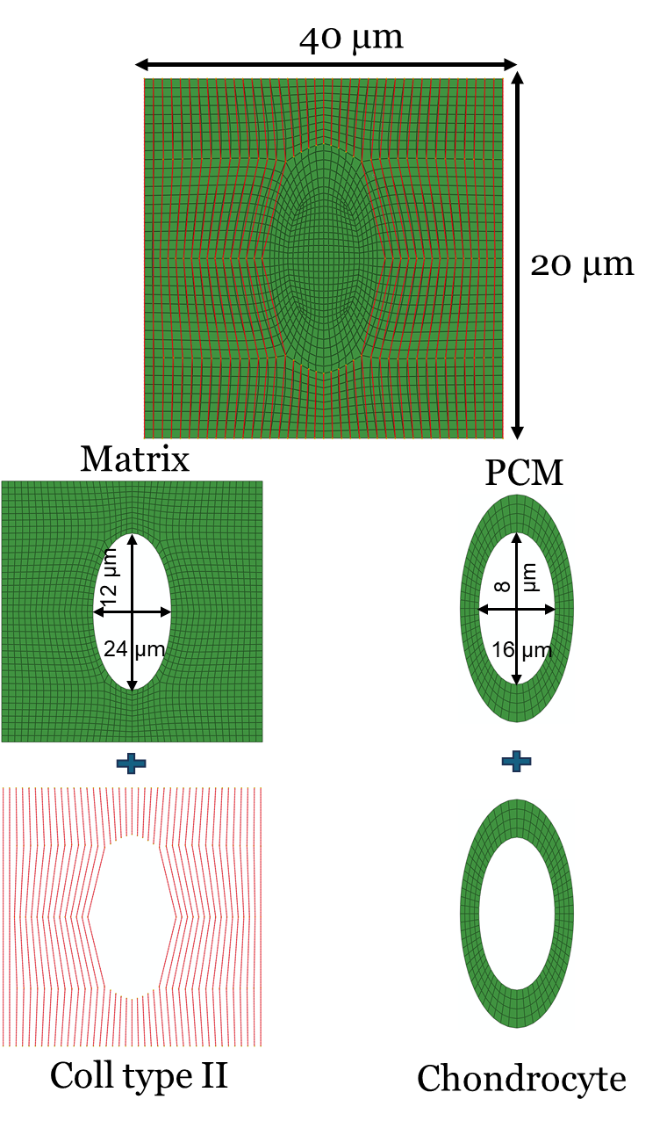
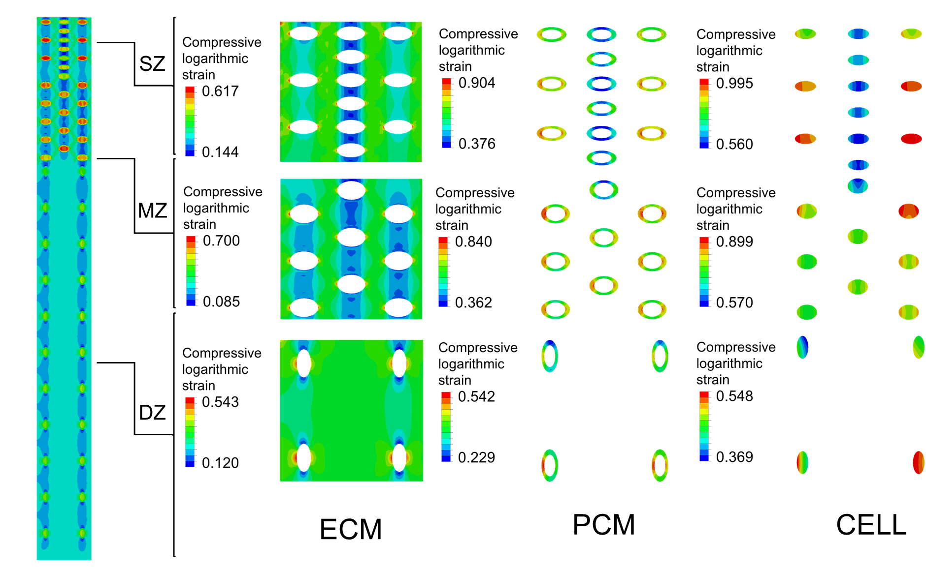
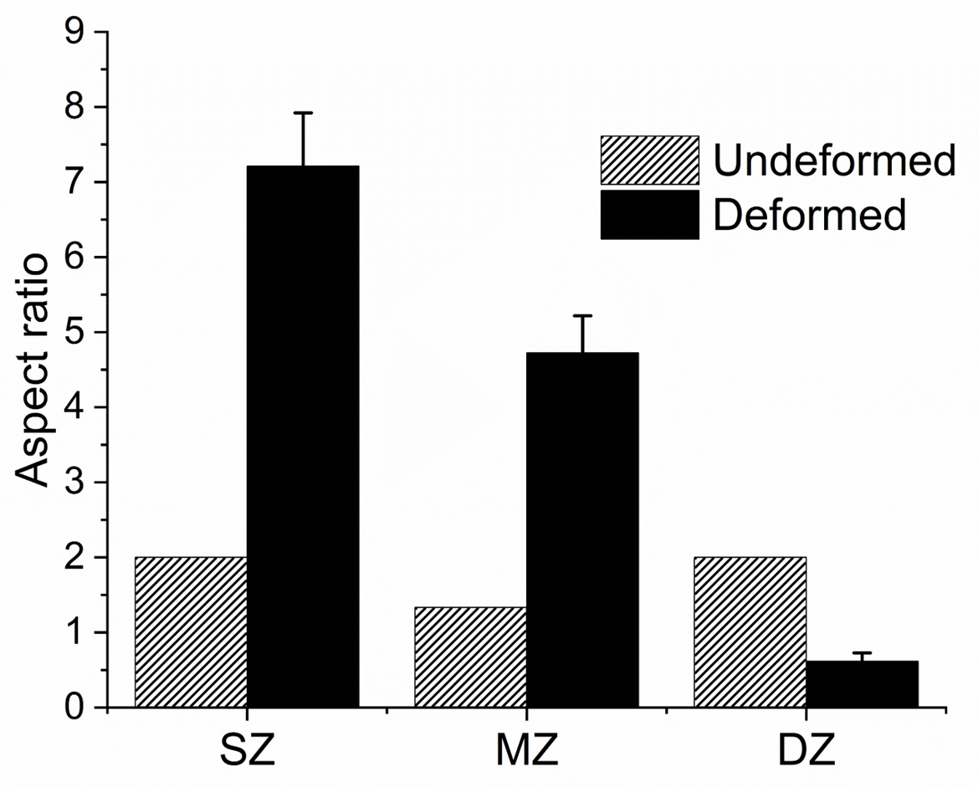
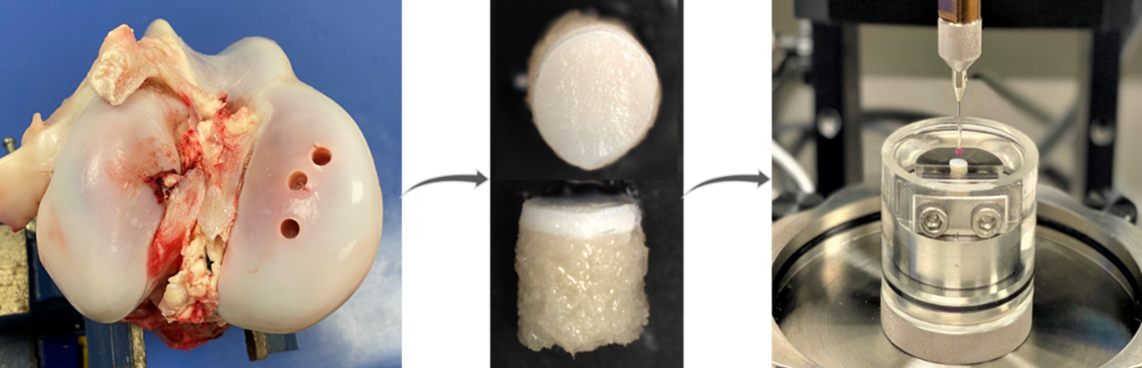
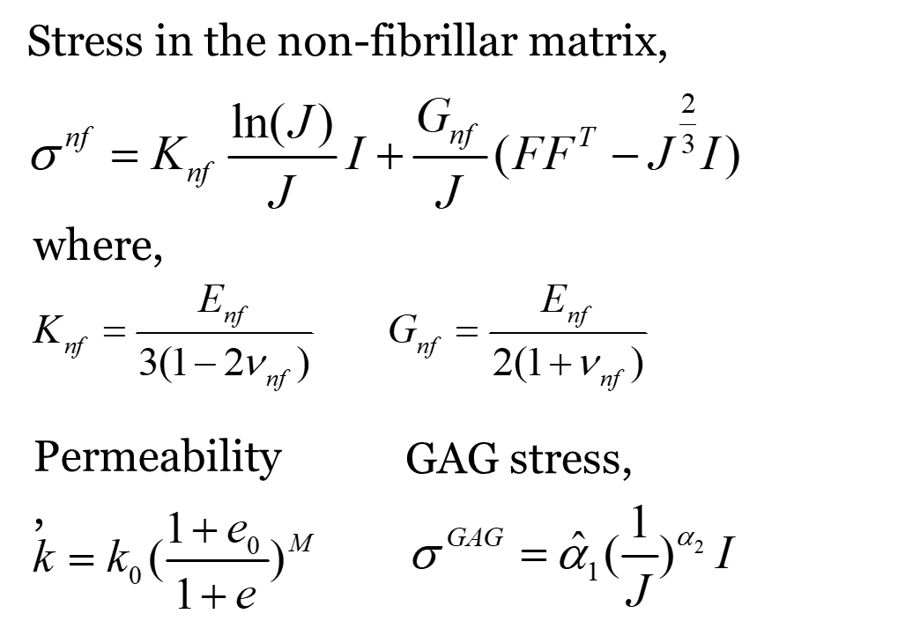
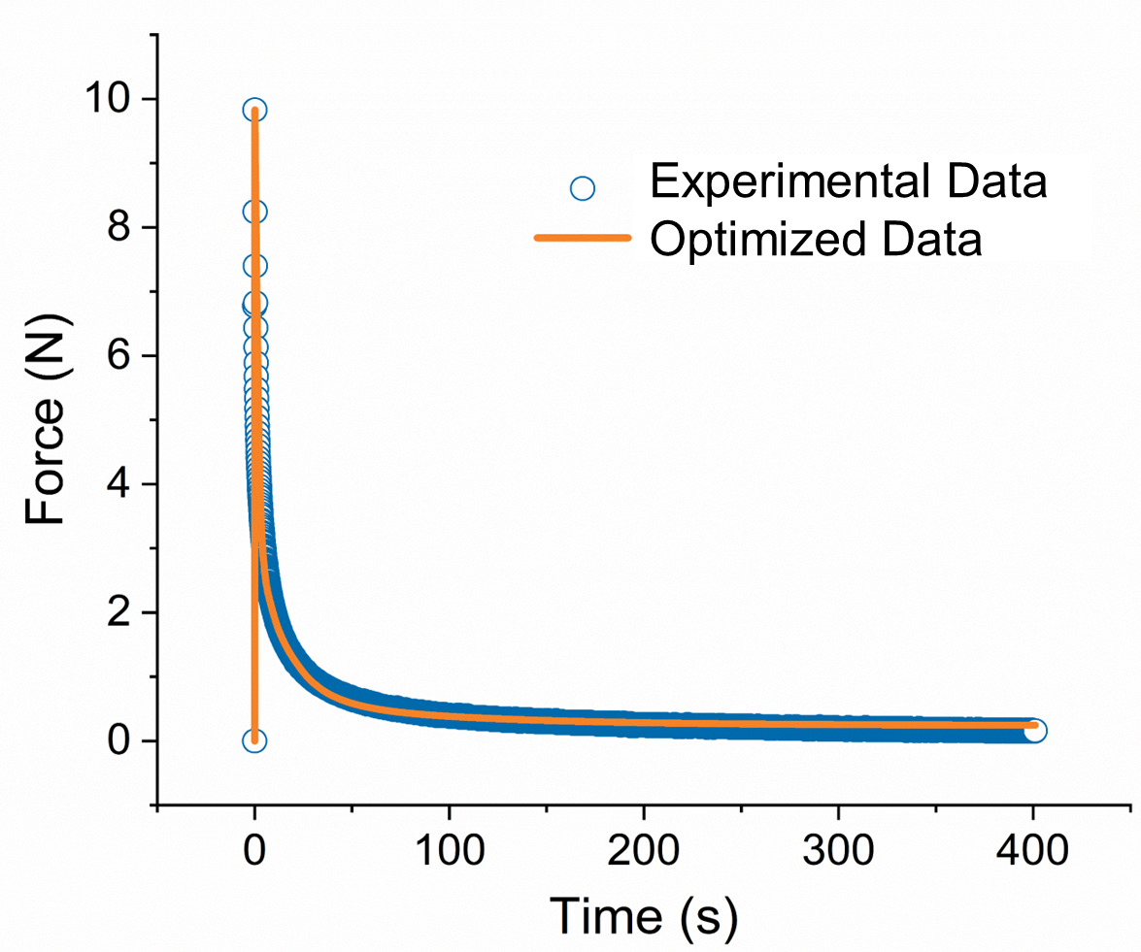
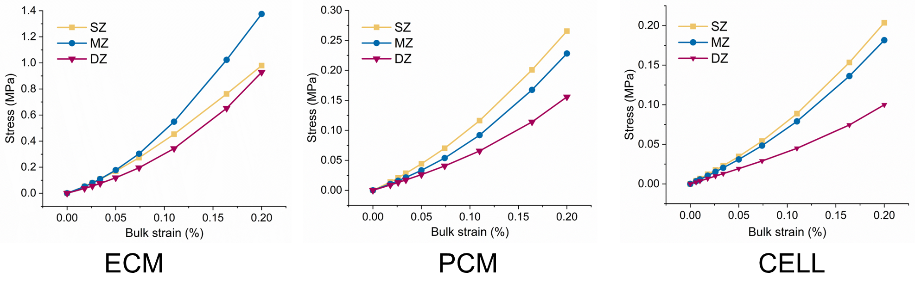
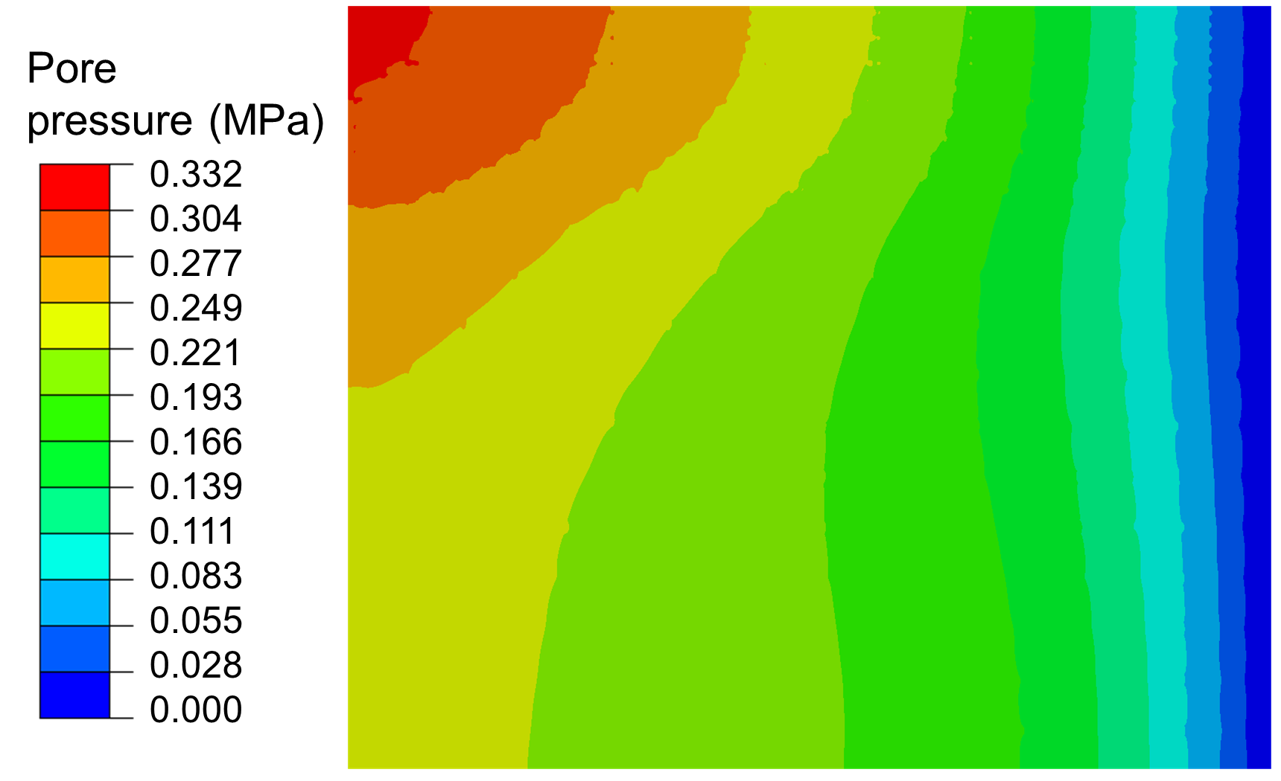
SZ
MZ
DZ
Microstructural organization of cartilage components
Development of multistructural finite element model to mimic the structure and organization of actual cartilage.
Stress-strain behavior of individual cartilage components and the porous effect
Experimental validation
Constitutive modeling via UMAT

Slide 3
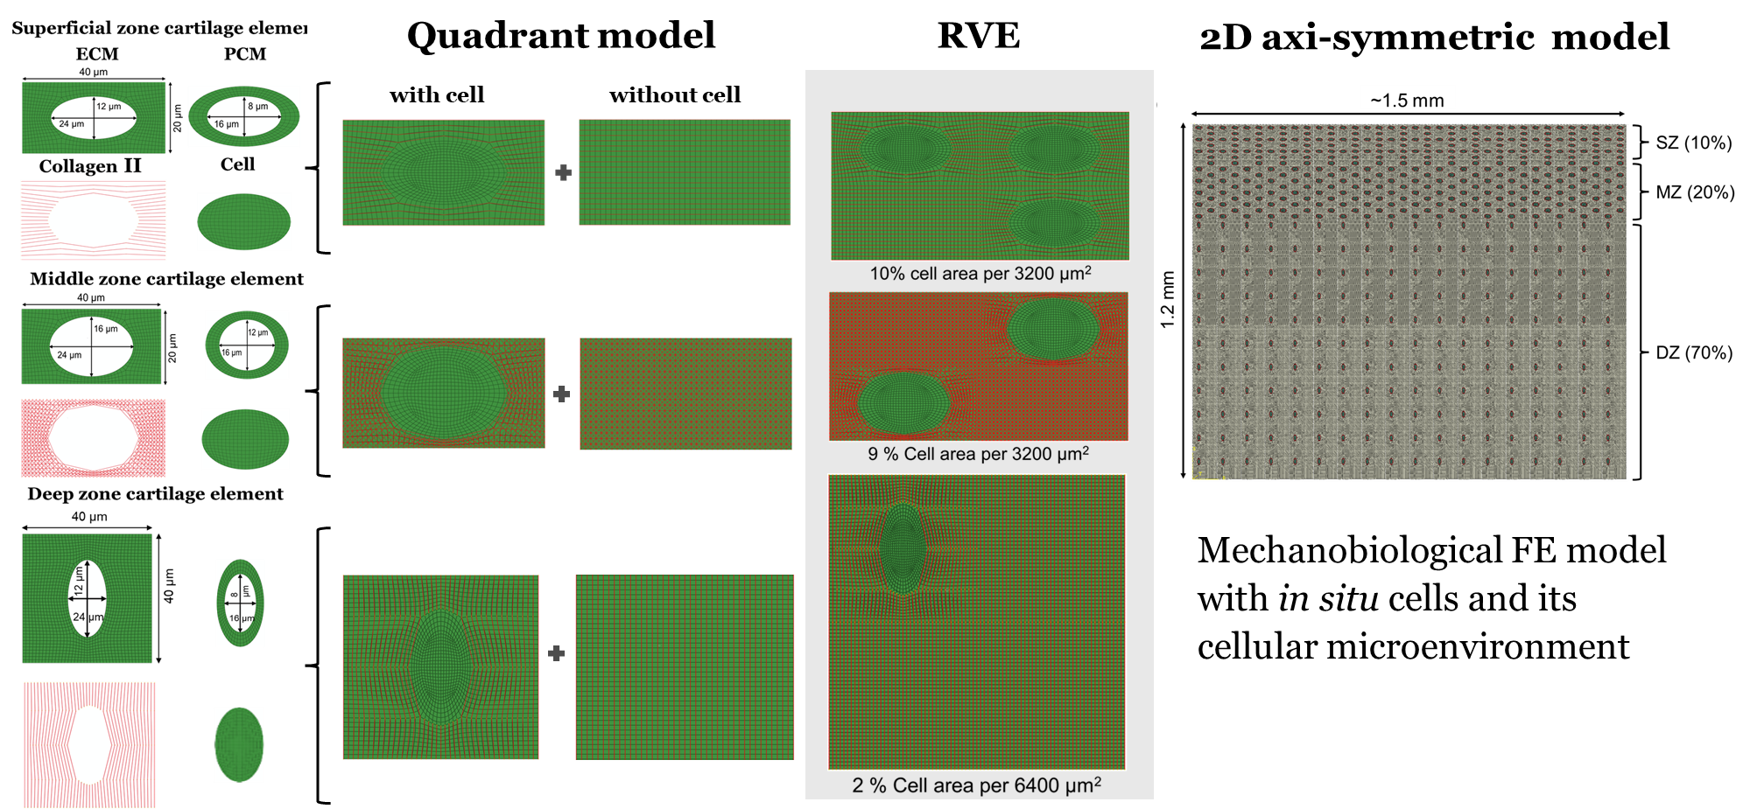

Slide 4
SZ
MZ
DZ
Microstructural organization of cartilage components
Development of multistructural finite element model to mimic the structure and organization of actual cartilage.
Stress-strain behavior of individual cartilage components and the porous effect
Experimental validation
Constitutive modeling via UMAT

Slide 5
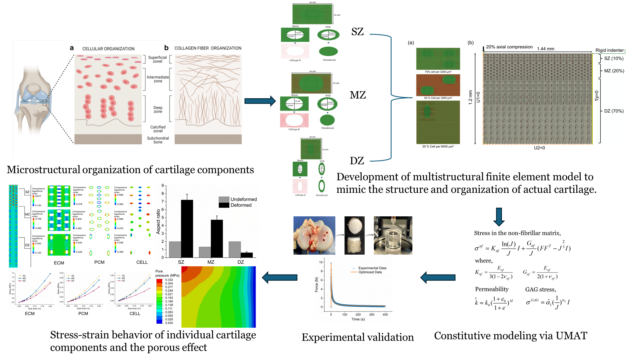

Slide 6
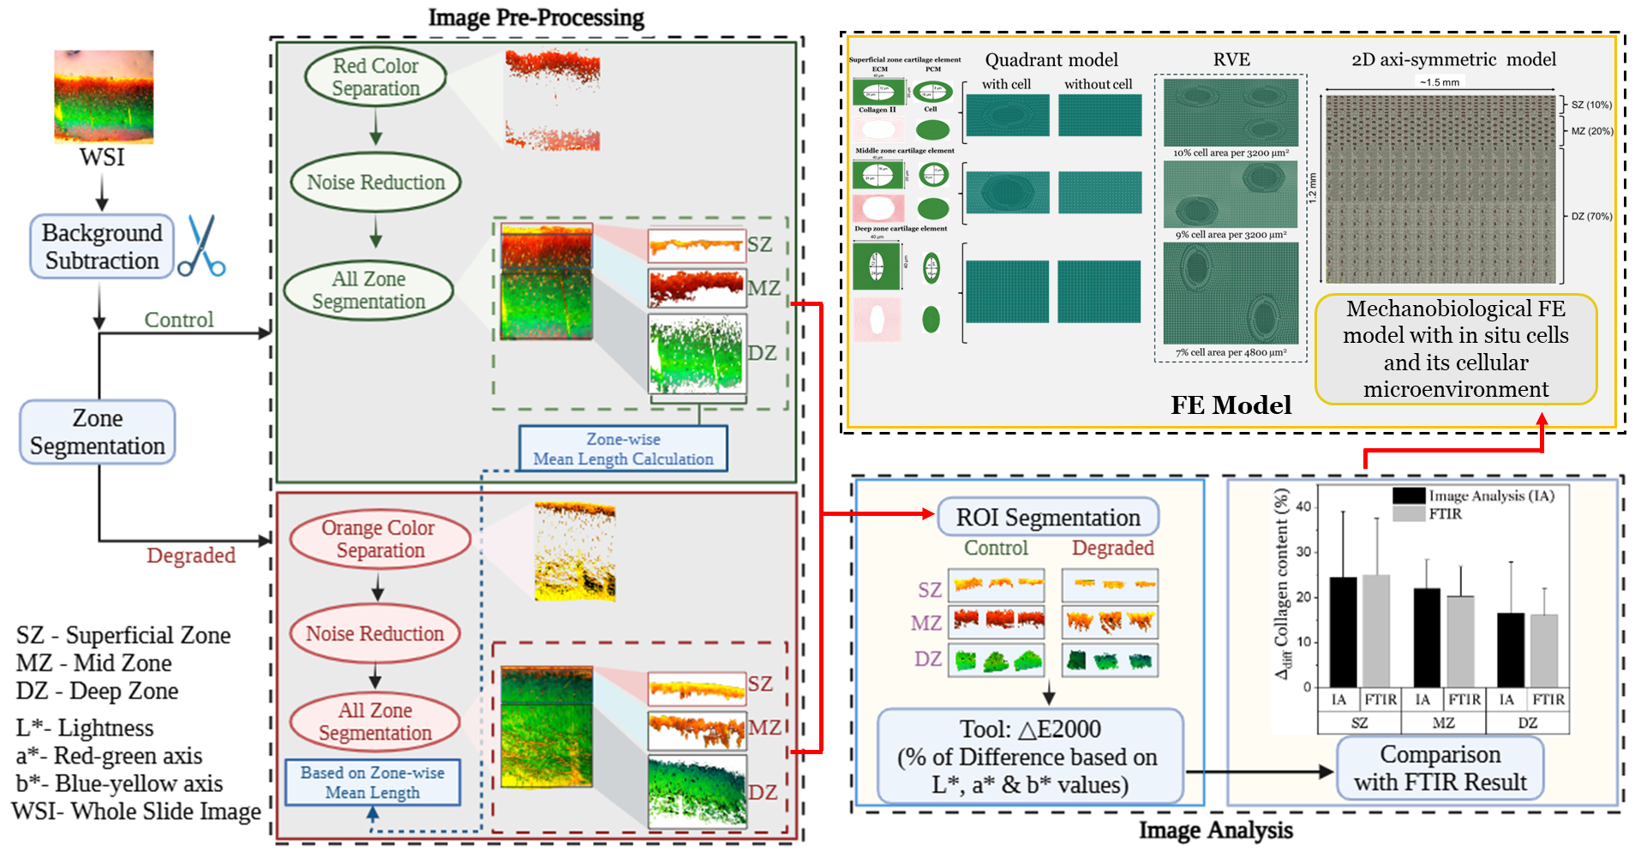
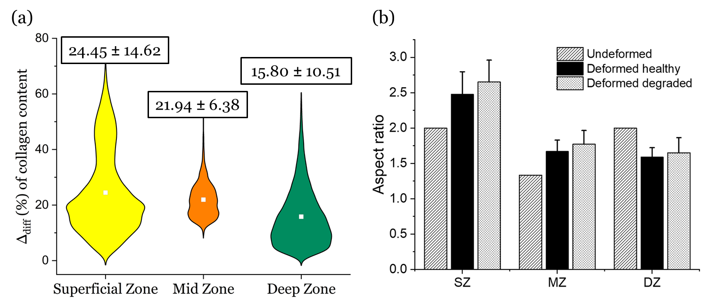

Slide 7
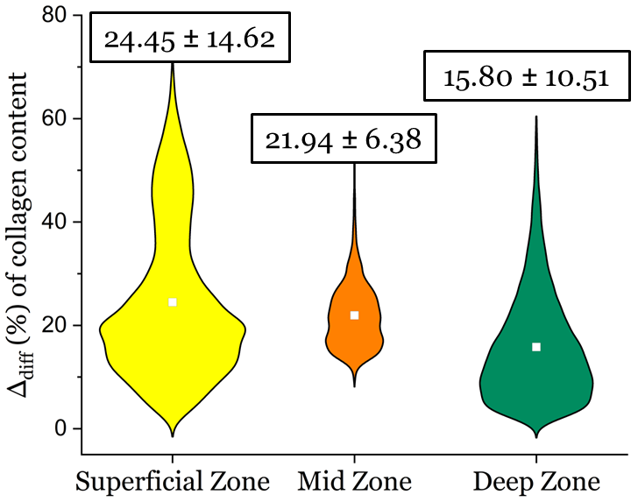
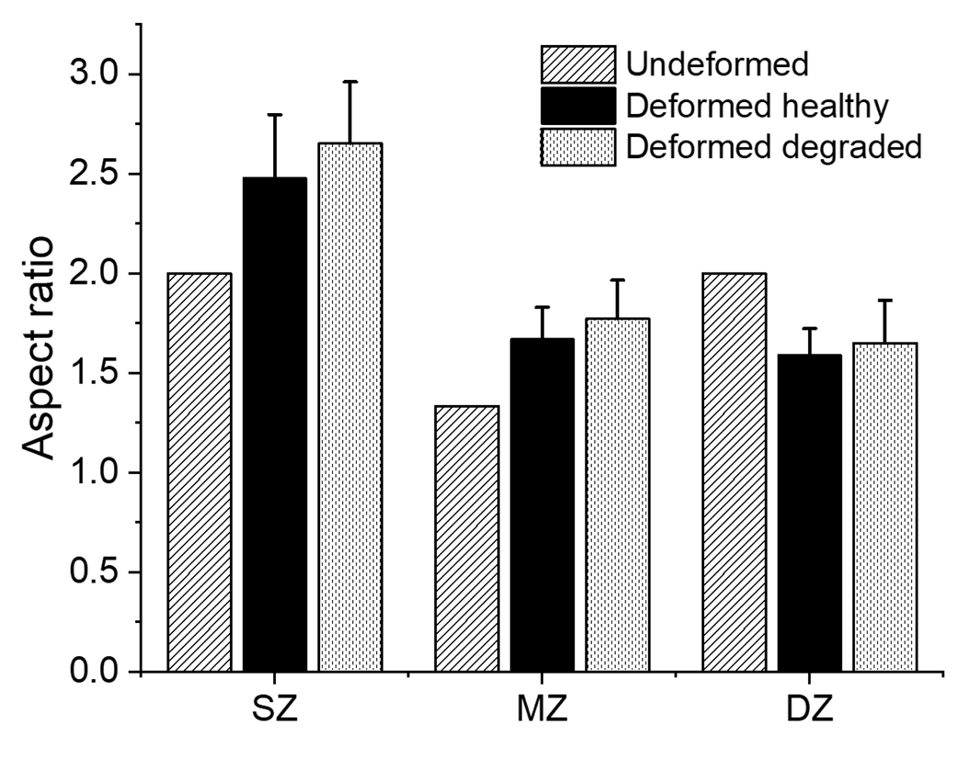
(a)
(b)

Slide 9
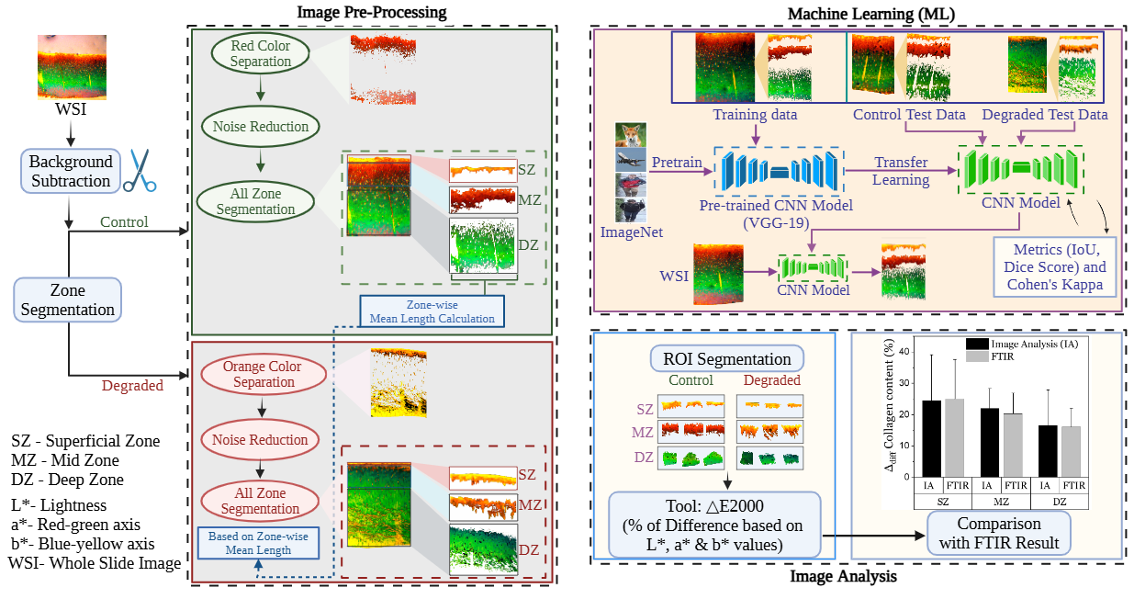
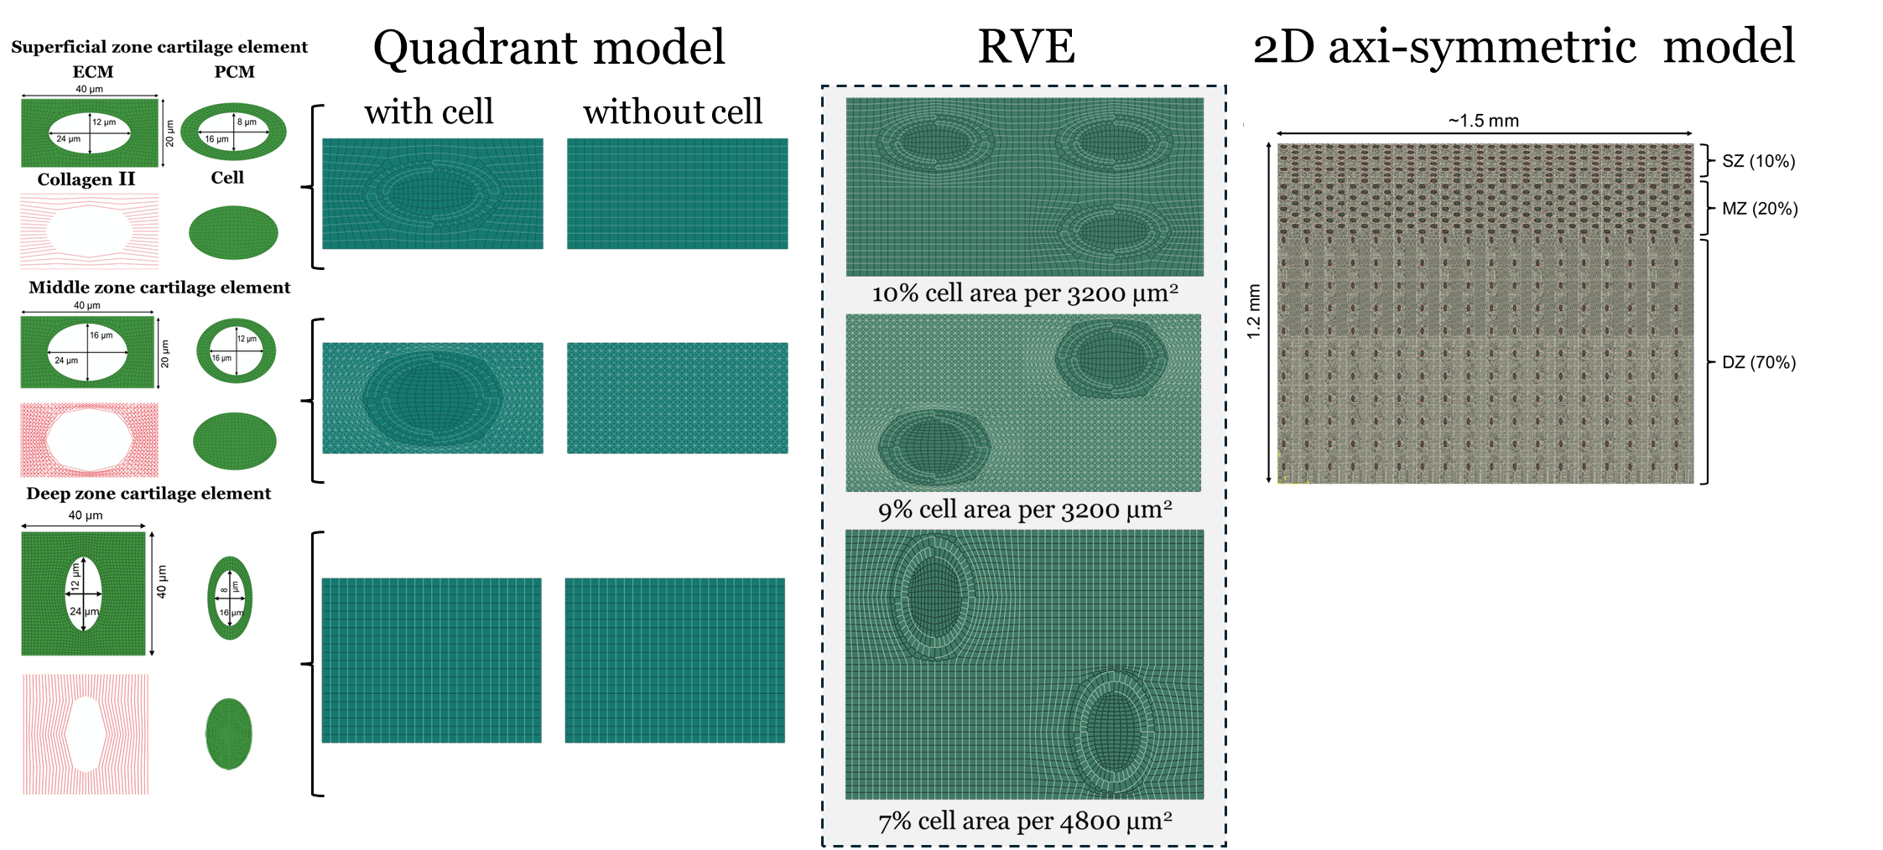
Workflow of Collagen Quantification
9
Mechanobiological FE model with in situ cells and its cellular microenvironment
FE Model
[Zhao et al. 2020]
Notes:
To quantify the fibrillar degradation, we considered Picrosirius Red stained polarized light micrographs for both healthy and enzymatically degraded cartilage. We considered a cocktail of MMPs-13 and 9 and ADAMTS-5 to degrade , MMPS are responsible for fibrillar degradation. From image micrographs, first, background was removed, and then the images were converted from BGR to HSV color space. Then, we extracted the red color range in HSV, refined it and isolate the MZ of the control/healthy samples. After that we segmented the SL and DL. However, for degraded samples, we found it difficult to identify the MZ alone, due to which we separated SL+ML altogether based on orange/yellow region and using the mean length of the control samples, we further segmented the SL and ML, and subsequently the DL as well.
*****************************************
1. Pre-Processing and Zone Segmentation
Background Removal: Images were manually separated from the background (Tool: Pi7).
Control Samples:
Converted image from BGR → HSV color space.
Extracted red color range in HSV → refined it → isolated the Mid Zone (MZ).
Using the MZ as reference, we separated Superficial Zone (SZ) and Deep Zone (DZ).
Calculated the mean thickness/length of SZ, MZ, DZ (used later as reference).
Degraded Samples:
Again converted BGR → HSV.
Extracted orange/yellow regions → refined → gave SZ + MZ together.
Divided SZ and MZ using the mean lengths from control.
ROI Segmentation: Both control and degraded samples were segmented zone-wise.
2. Quantitative Image Analysis
Compared segmented zones using ΔE2000 analysis:
Works in the Lab color space (L*: lightness, a*: red-green, b*: blue-yellow).
Reflects how human eye perceives color differences more accurately than simple RGB difference.
Results were compared with FTIR.
3. Machine Learning Pipeline
Input Data: Whole Slide Images (WSIs) with labelled masks (SZ, MZ, DZ).
Model: We will use a pre-trained CNN model (VGG-19) that was originally trained on the ImageNet dataset. Through transfer learning, we will fine-tune this model on our cartilage dataset so that it learns zone-specific features. The adapted model will then be tested on unseen data, and its performance will be evaluated using metrics such as IoU, Dice Score, and Cohen’s Kappa. Based on these results, the model will be further fine-tuned to optimize accuracy for our task
Goal: Automate zone segmentation so the model can process new unseen WSIs and directly output SZ, MZ, DZ.
4. Evaluation Metrics
IoU (Intersection over Union): Measures overlap between predicted and ground-truth segmentation (higher = better).
Dice Score: Emphasizes the balance between false positives and false negatives.
Cohen’s Kappa: Statistical measure of agreement between model prediction and ground truth, adjusted for chance.

Slide 10
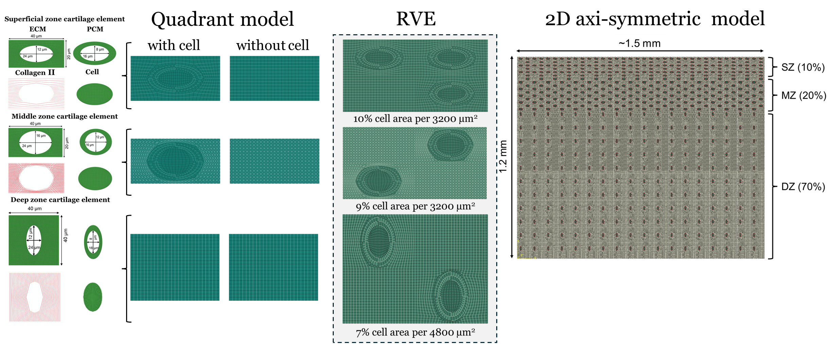
Workflow of Collagen Quantification
10
Mechanobiological FE model with in situ cells and its cellular microenvironment
FE Model
[Zhao et al. 2020]
Notes:
To quantify the fibrillar degradation, we considered Picrosirius Red stained polarized light micrographs for both healthy and enzymatically degraded cartilage. We considered a cocktail of MMPs-13 and 9 and ADAMTS-5 to degrade , MMPS are responsible for fibrillar degradation. From image micrographs, first, background was removed, and then the images were converted from BGR to HSV color space. Then, we extracted the red color range in HSV, refined it and isolate the MZ of the control/healthy samples. After that we segmented the SL and DL. However, for degraded samples, we found it difficult to identify the MZ alone, due to which we separated SL+ML altogether based on orange/yellow region and using the mean length of the control samples, we further segmented the SL and ML, and subsequently the DL as well.
*****************************************
1. Pre-Processing and Zone Segmentation
Background Removal: Images were manually separated from the background (Tool: Pi7).
Control Samples:
Converted image from BGR → HSV color space.
Extracted red color range in HSV → refined it → isolated the Mid Zone (MZ).
Using the MZ as reference, we separated Superficial Zone (SZ) and Deep Zone (DZ).
Calculated the mean thickness/length of SZ, MZ, DZ (used later as reference).
Degraded Samples:
Again converted BGR → HSV.
Extracted orange/yellow regions → refined → gave SZ + MZ together.
Divided SZ and MZ using the mean lengths from control.
ROI Segmentation: Both control and degraded samples were segmented zone-wise.
2. Quantitative Image Analysis
Compared segmented zones using ΔE2000 analysis:
Works in the Lab color space (L*: lightness, a*: red-green, b*: blue-yellow).
Reflects how human eye perceives color differences more accurately than simple RGB difference.
Results were compared with FTIR.
3. Machine Learning Pipeline
Input Data: Whole Slide Images (WSIs) with labelled masks (SZ, MZ, DZ).
Model: We will use a pre-trained CNN model (VGG-19) that was originally trained on the ImageNet dataset. Through transfer learning, we will fine-tune this model on our cartilage dataset so that it learns zone-specific features. The adapted model will then be tested on unseen data, and its performance will be evaluated using metrics such as IoU, Dice Score, and Cohen’s Kappa. Based on these results, the model will be further fine-tuned to optimize accuracy for our task
Goal: Automate zone segmentation so the model can process new unseen WSIs and directly output SZ, MZ, DZ.
4. Evaluation Metrics
IoU (Intersection over Union): Measures overlap between predicted and ground-truth segmentation (higher = better).
Dice Score: Emphasizes the balance between false positives and false negatives.
Cohen’s Kappa: Statistical measure of agreement between model prediction and ground truth, adjusted for chance.

Slide 11
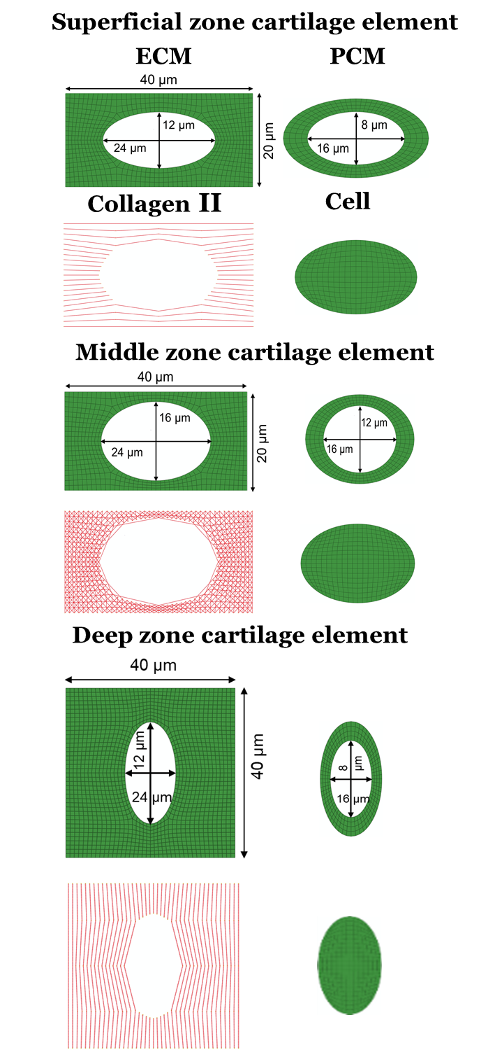
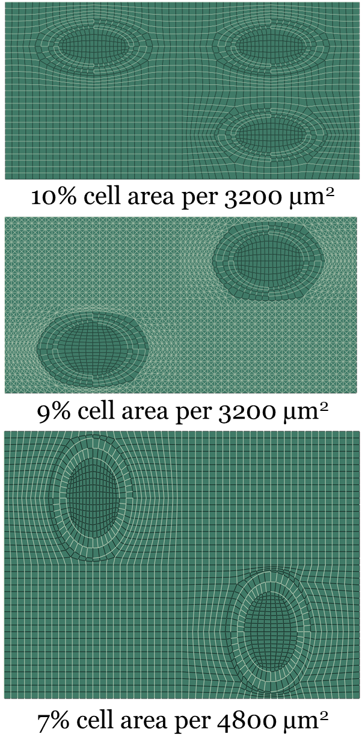
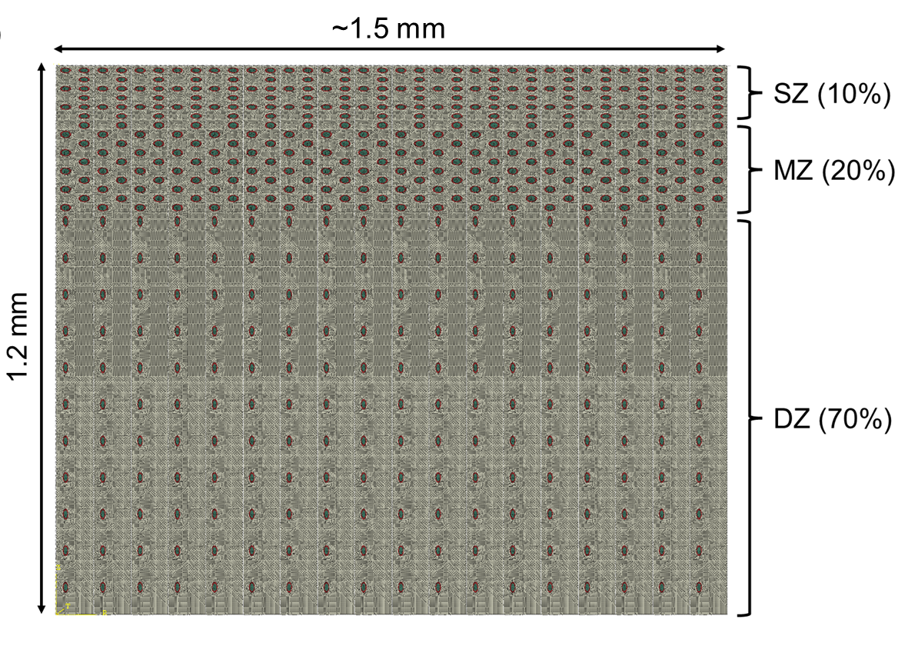
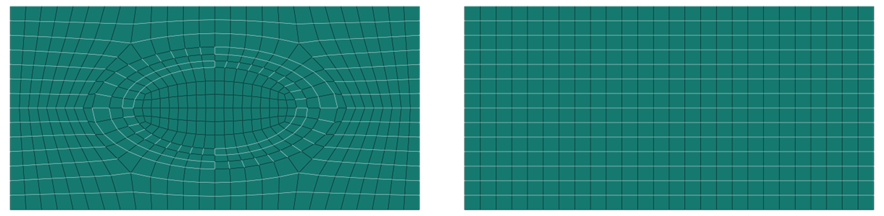
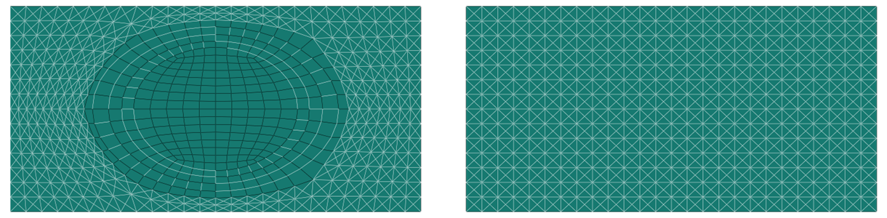
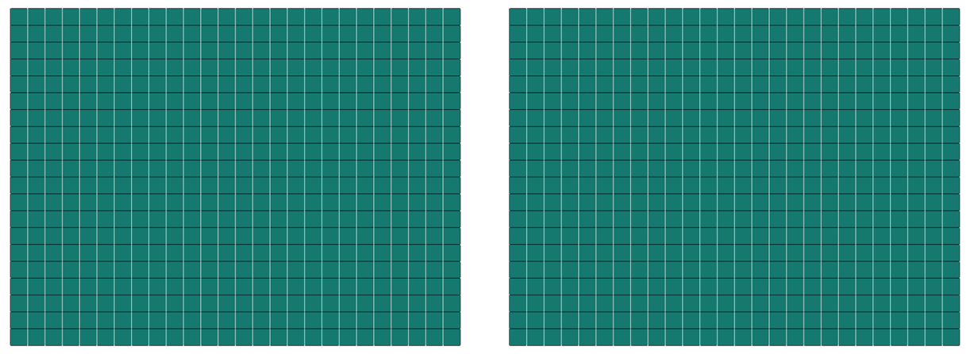
Quadrant model
RVE
2D axi-symmetric model
with cell
without cell

Slide 12
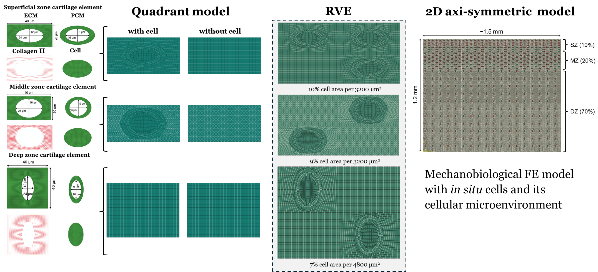

Slide 13
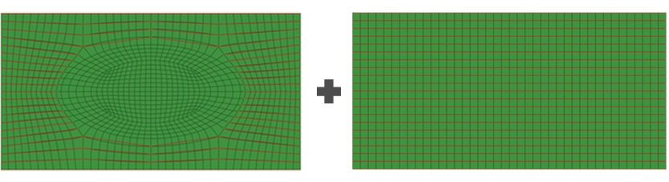
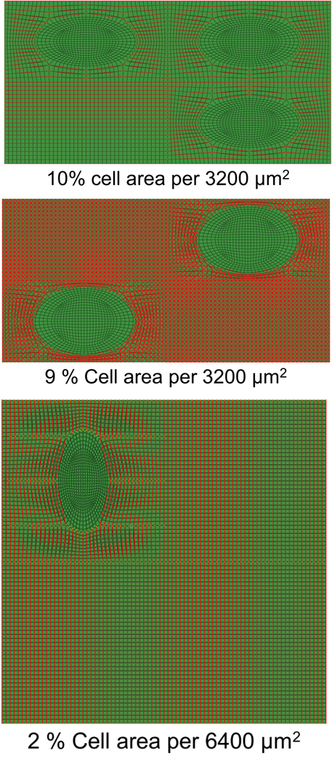
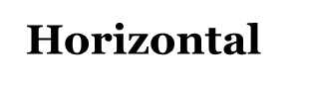
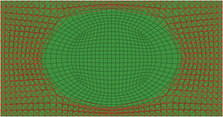
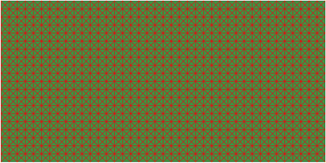
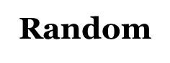
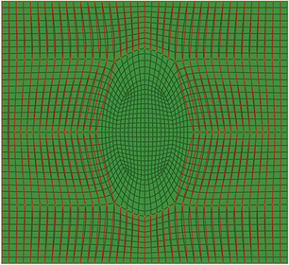
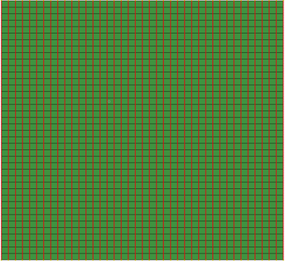
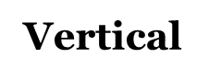
M²FE Model Construction
Multi-structural fibril-reinforced poro-hyperelastic (MS-FRPHE) finite element model
Quadrant model
RVE
2D axi-symmetric model
with cell
without cell
Mechanobiological FE model with in situ cells and its cellular microenvironment
Jadin et al. 2005
Notes:
Experimentally determined cell distributions

Slide 14
M²FE Model Construction
Multi-structural fibril-reinforced poro-hyperelastic (MS-FRPHE) finite element model
Quadrant model
RVE
2D axi-symmetric model
with cell
without cell
Mechanobiological FE model with in situ cells and its cellular microenvironment
Jadin et al. 2005
Notes:
Experimentally determined cell distributions

Slide 15
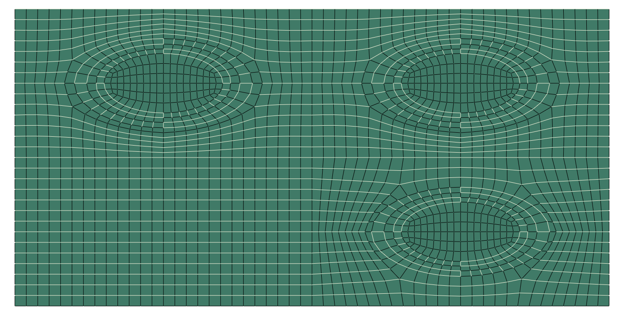
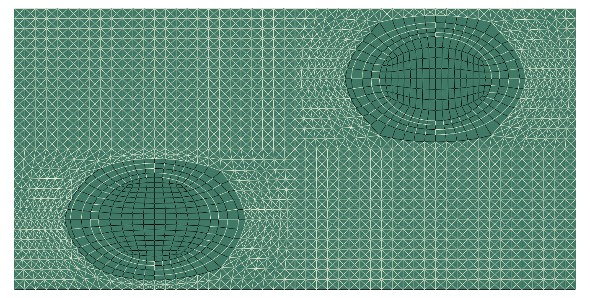
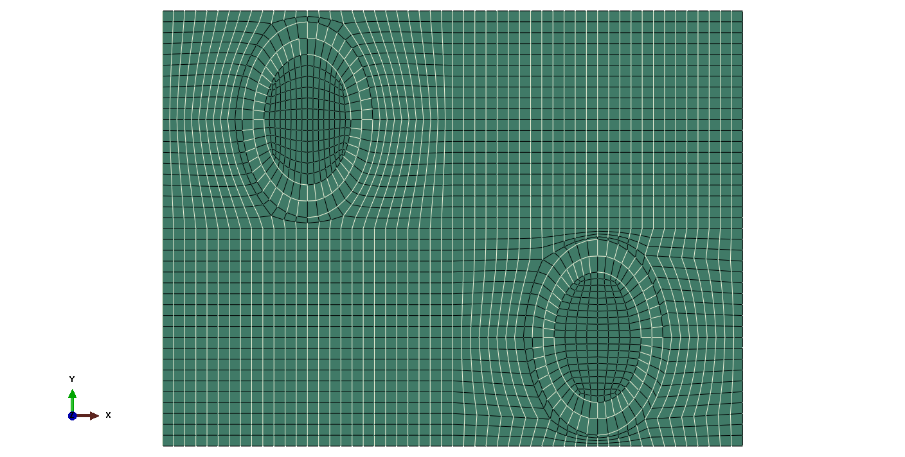
Quadrant model
with cell
without cell
10% cell area per 3200 µm²
9% cell area per 3200 µm²
7% cell area per 4800 µm²

Slide 16
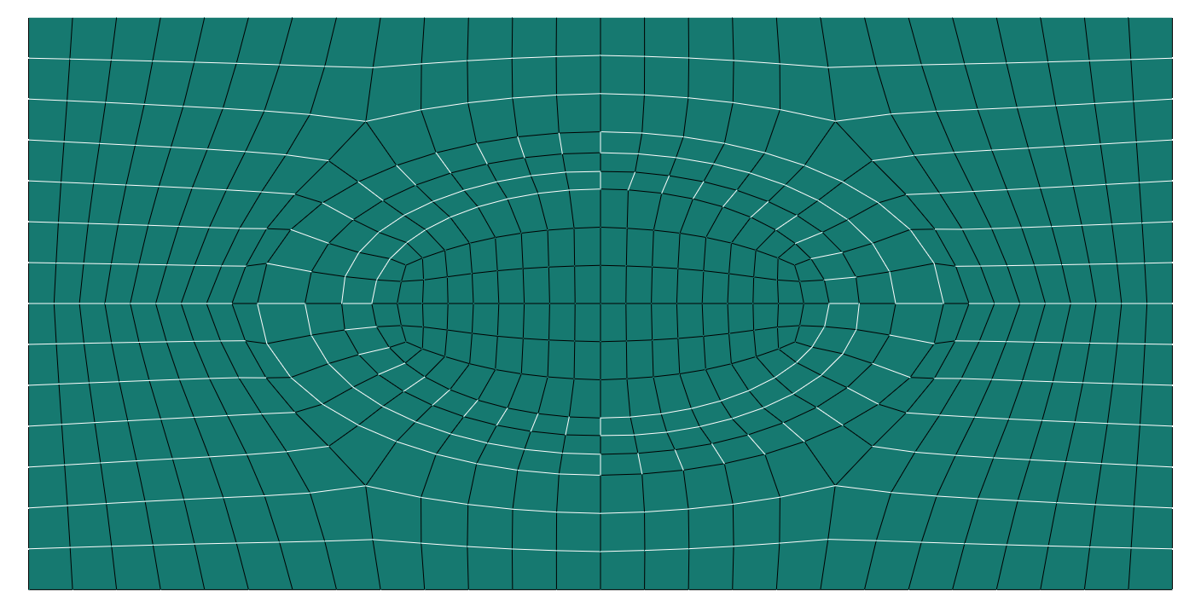
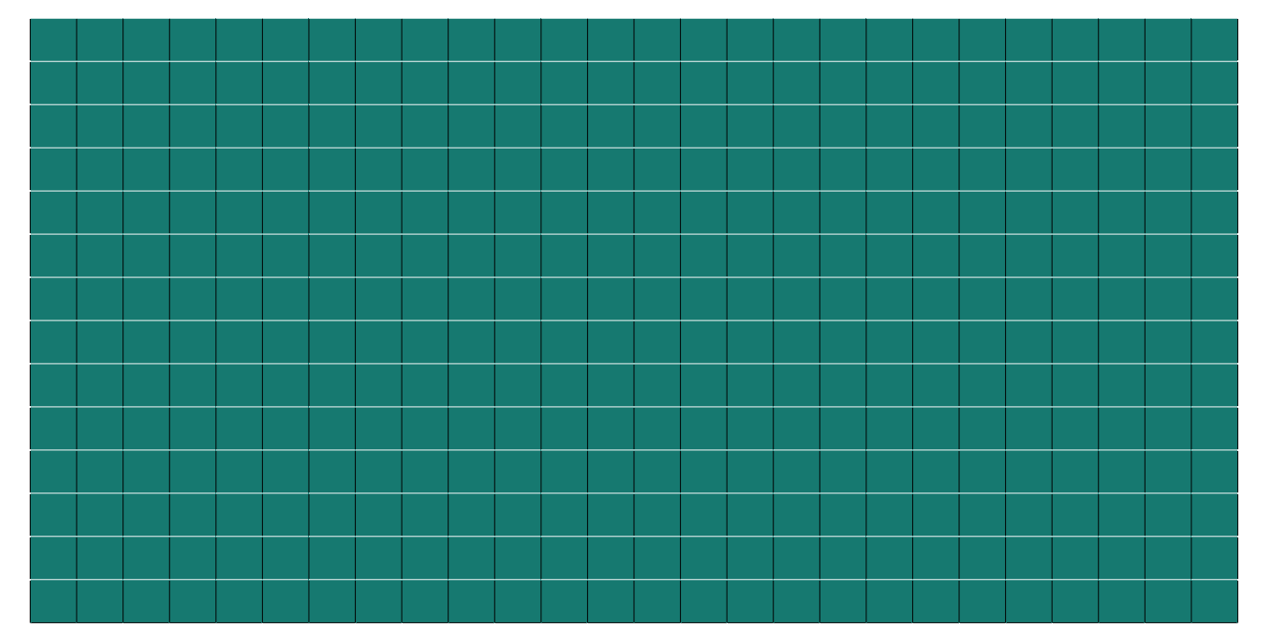
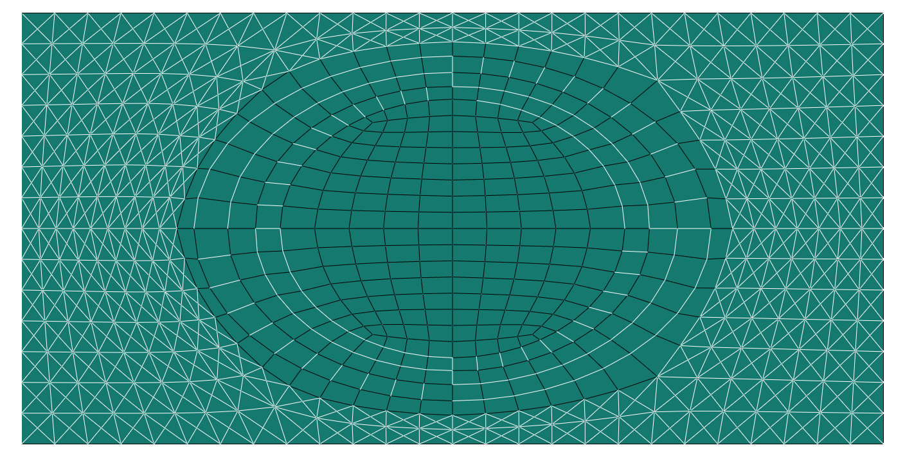
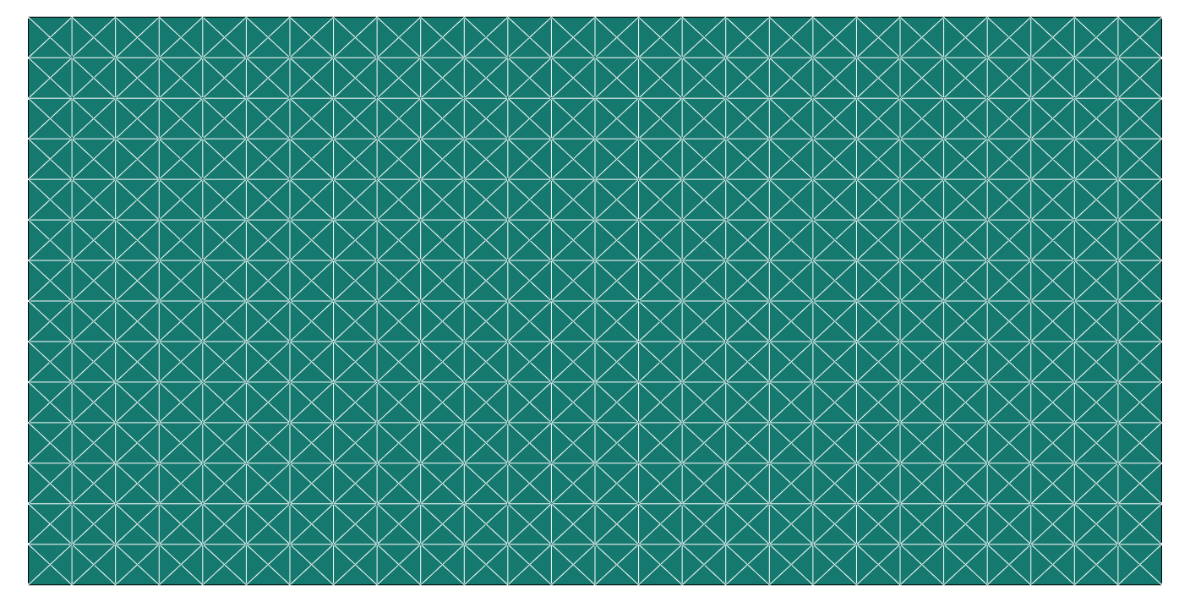
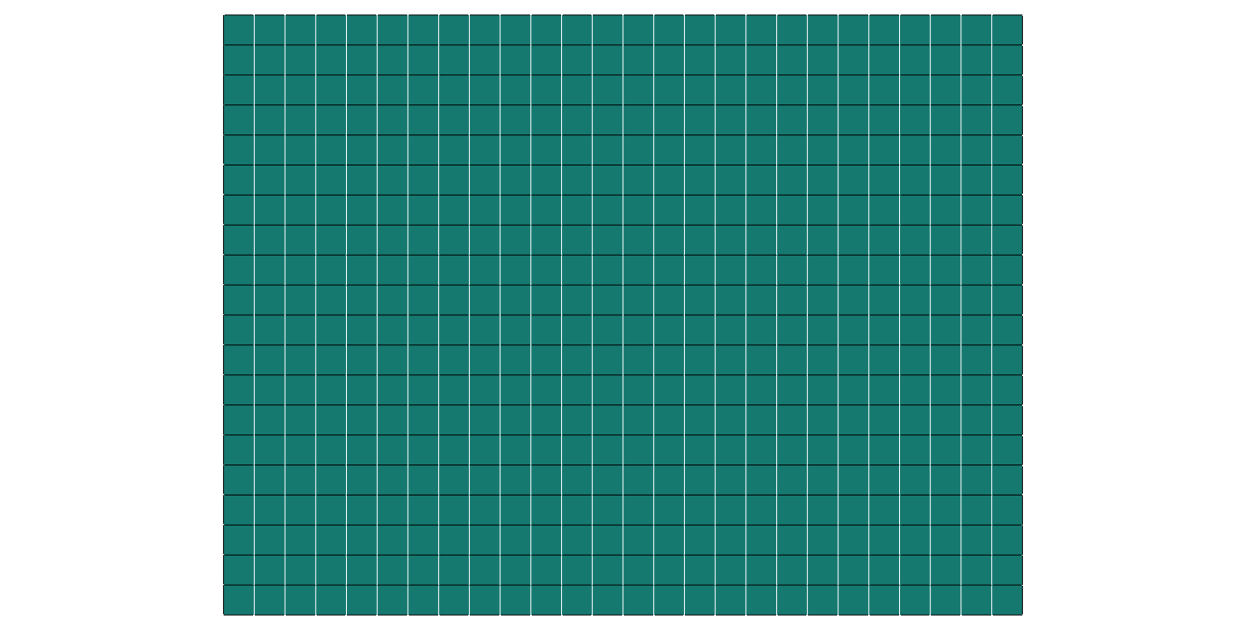
Quadrant model
with cell
without cell

